Slide 1
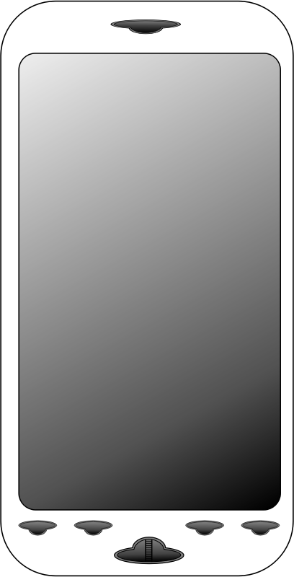
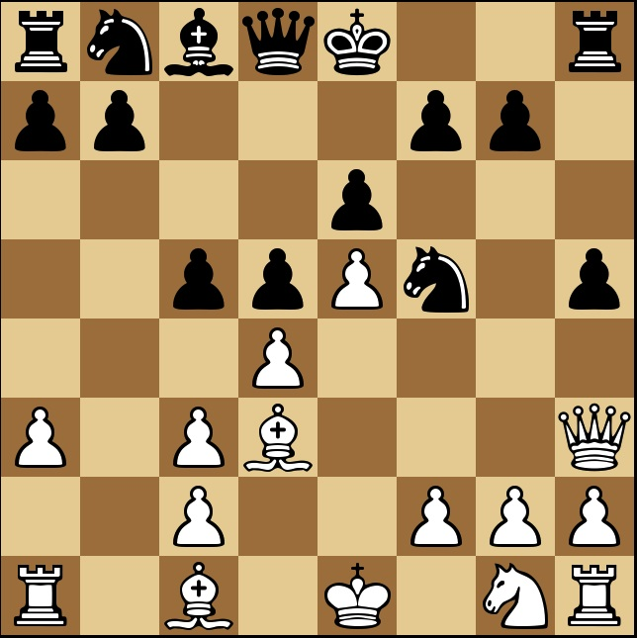
Use-Case: Convert an Image of a chessboard into an actual digital chess board, using a simple image classifier 3-Layer NN architecture.
Black Knight on b8
White Bishop on d3

Slide 2
y = [3 1 2 0 4 8 6 7 5 9 12 11 10]
0 0 0 1 0 0 0 0 0 0 0 0
0
0 1 0 0 0 0 0 0 0 0 0 0
0
0 0 1 0 0 0 0 0 0 0 0 0
0
1 0 0 0 0 0 0 0 0 0 0 0
0
0 0 0 0 1 0 0 0 0 0 0 0
0
0 0 0 0 0 0 0 0 1 0 0 0
0
0 0 0 0 0 0 1 0 0 0 0 0
0
0 0 0 0 0 0 0 1 0 0 0 0
0
0 0 0 0 0 1 0 0 0 0 0 0
0
1 0 0 0 0 0 0 0 0 1 0 0
0
0 0 0 0 1 0 0 0 0 0 0 0
1
0 0 0 0 0 0 0 0 0 0 0 1
0
0 0 0 0 0 0 0 0 0 0 1 0
0
class = 0 (Empty)
class = 1 (White Pawn)
class = 2 (White Knight)
class = 3 (White Bishop)
class = 4 (White Rook)
class = 5 (White Queen)
class = 6 (White King)
class = 7 (Black Pawn)
class = 8 (Black Knight)
class = 9 (Black Bishop)
class = 10 (Black Rook)
class = 11 (Black Queen)
class = 12 (Black King)

Slide 3

3-Layer Neural Network
Input Layer
Hidden Layer 1
Hidden Layer 2
Output Layer 3
X: (12288,1)
W1: (26,12288) b1: (26,1)
W1: (26,26) b1: (26,1)
W1: (13,26) b1: (13,1)
1
2
3
X0
Z0
Z0
Z0
1
2
3
X1
Z1
Z1
Z1
1
2
3
X2
Z2
Z2
Z2
.
.
.
.
.
.
.
.
.
.
.
.
.
.
.
.
.
.
.
.
.
.
.
.
.
.
.
.
.
.
.
.
.
.
.
.
Image 2 vector
1
2
3
X12288
Z26
Z26
Z13

Slide 4
